Slide 1

Embedded Sensing and Control for High-Speed Electro-Hydraulic Soft Robots
Khoi Ly
Comprehensive Exam
Paul M. Rady Department of Mechanical Engineering
Nikolaus Correll Mark E. Rentschler Christoph Keplinger Robert MacCurdy Alessandro Roncone
May 18th, 2021

Slide 2
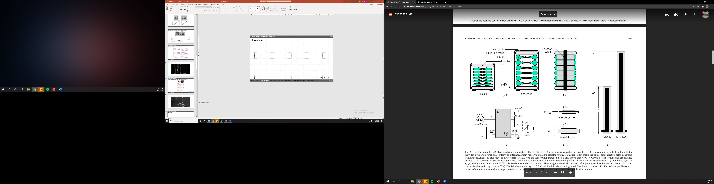
Capacitive sensor wrap
Johnson, Sundaram, Narris, Acome, Ly, et. al. (2020). RA-L
Introduction
Electro-hydraulic Actuator
Research Aim 1
Research Aim 2
Proposed works
References
Slide 2

Slide 3
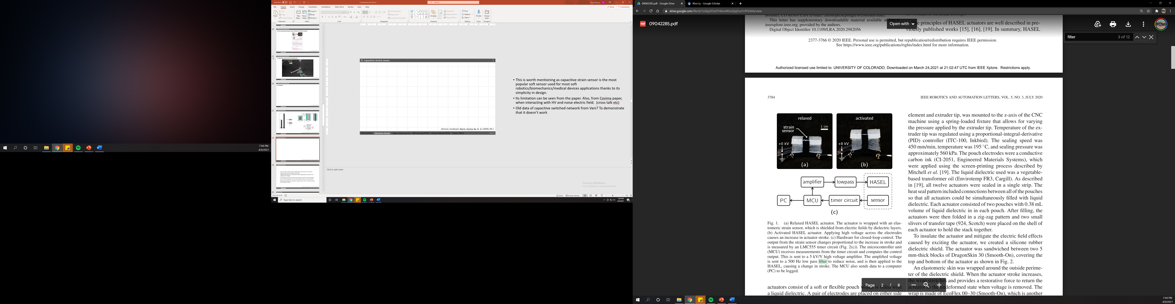
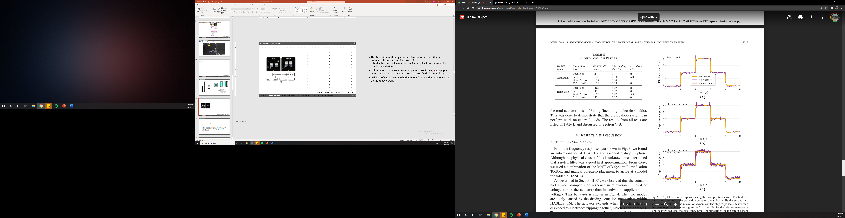
Johnson, Sundaram, Narris, Acome, Ly, et. al. (2020). RA-L
Introduction
Electro-hydraulic Actuator
Research Aim 1
Research Aim 2
Proposed works
References
Slide 3

Slide 4
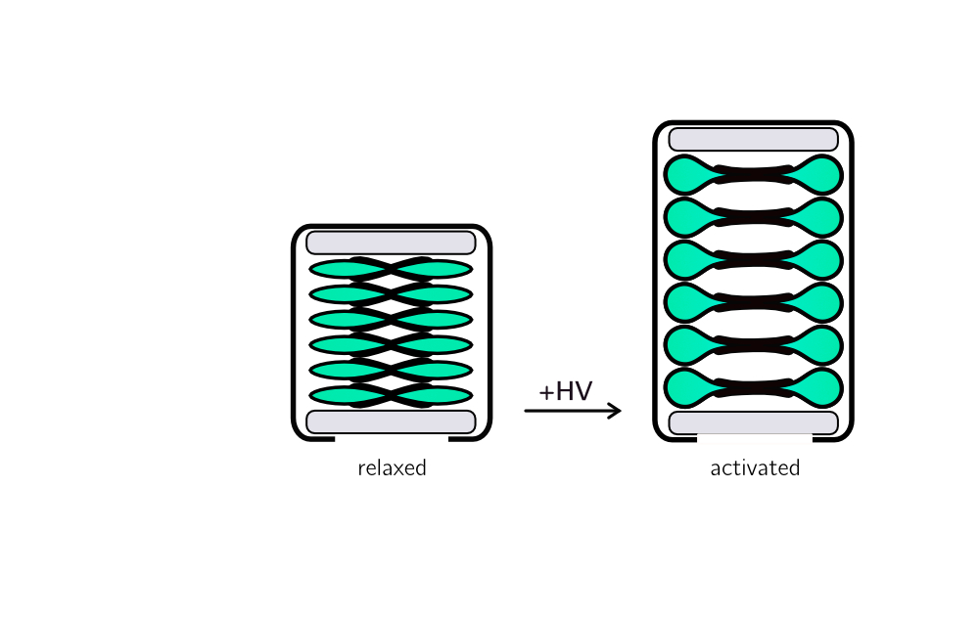
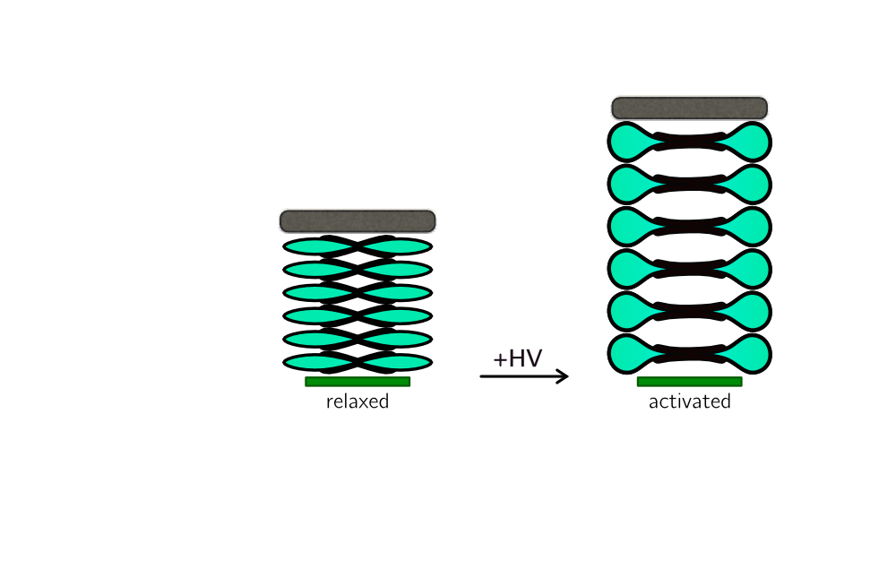
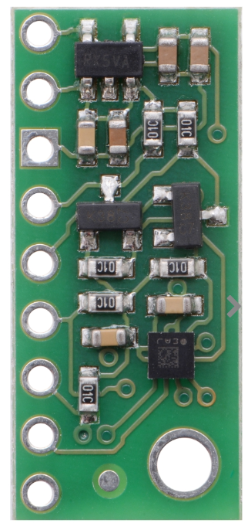
Sensor wrap
Magnetic block
N
Dielectric shield
S
N
S
Noisy sensor data due to actuator’s electric field
LIS3MDL magnetometer
3-axis magnetometer
Complex fabrication process; sensor is prone to viscoelastic effect and failure
Low sampling rate
Sundaram, Ly, et. al. (In preparation)
Introduction
Electro-hydraulic Actuator
Research Aim 1
Research Aim 2
Proposed works
References
Slide 4

Slide 5
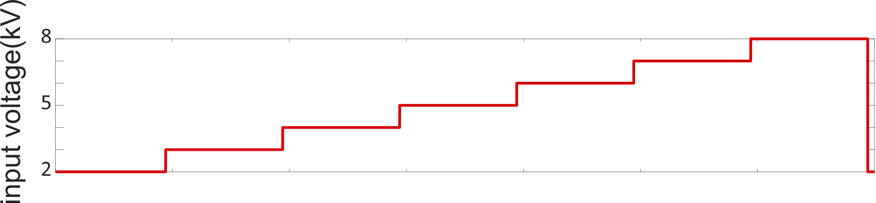
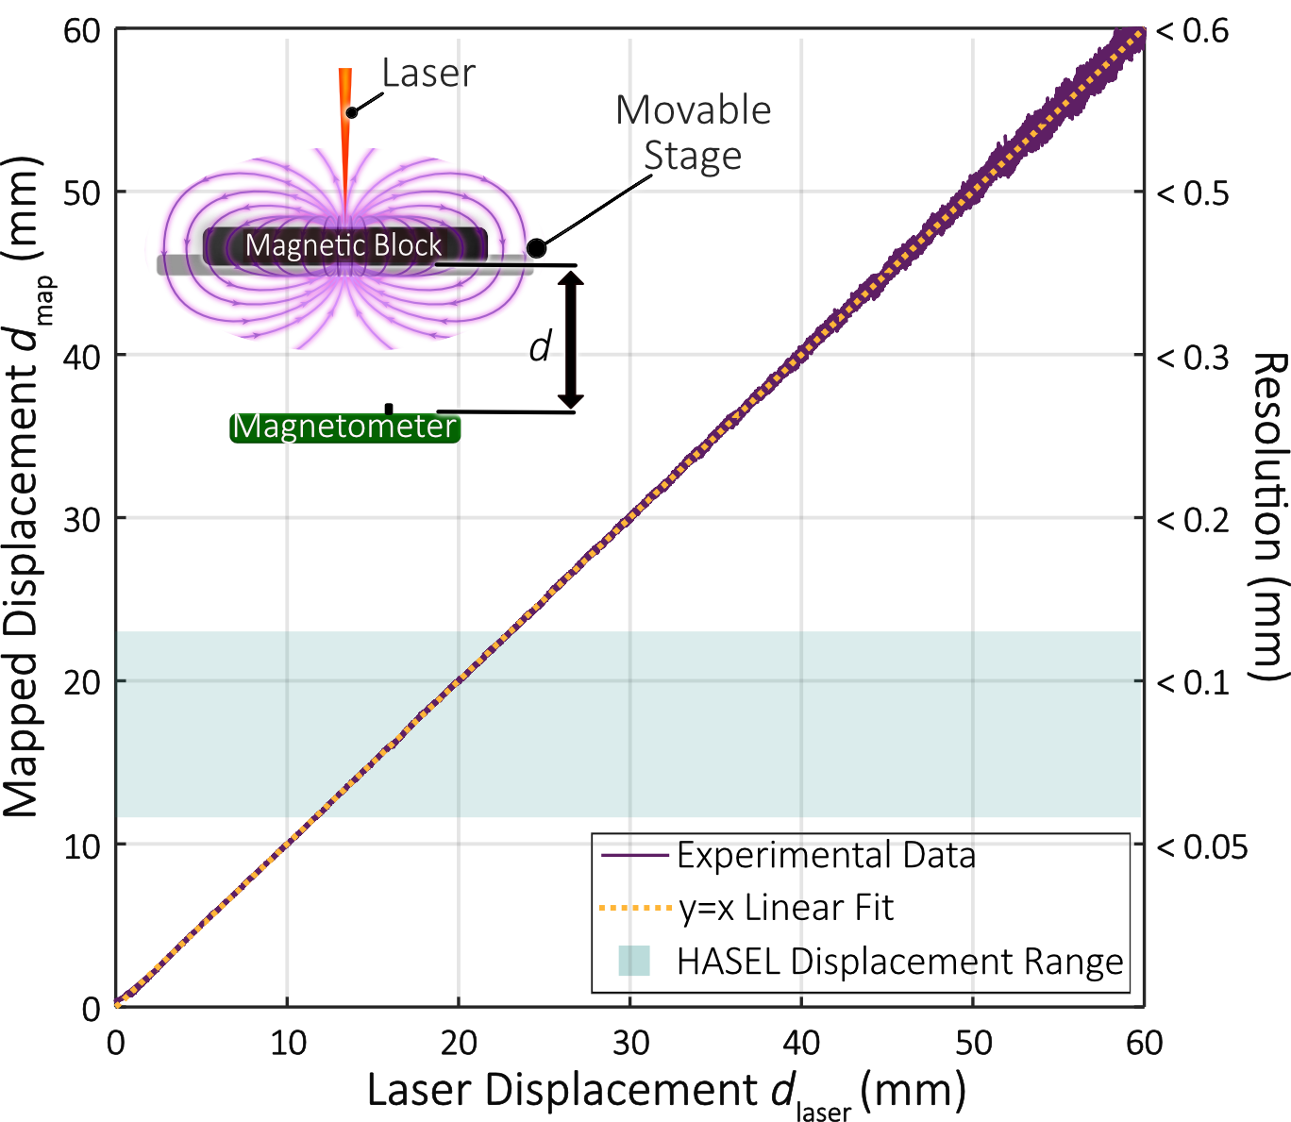
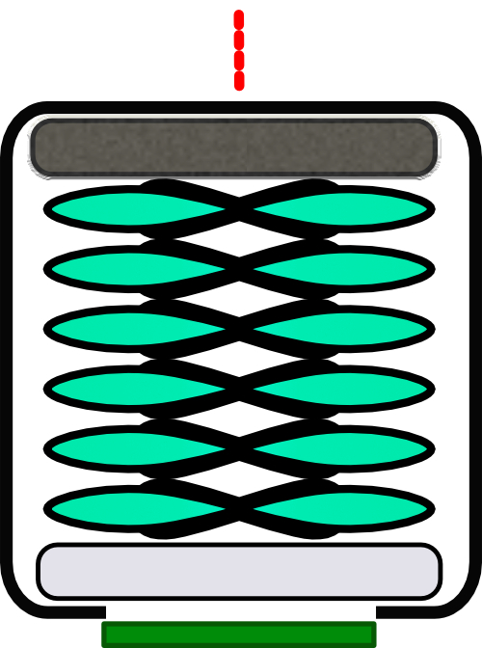
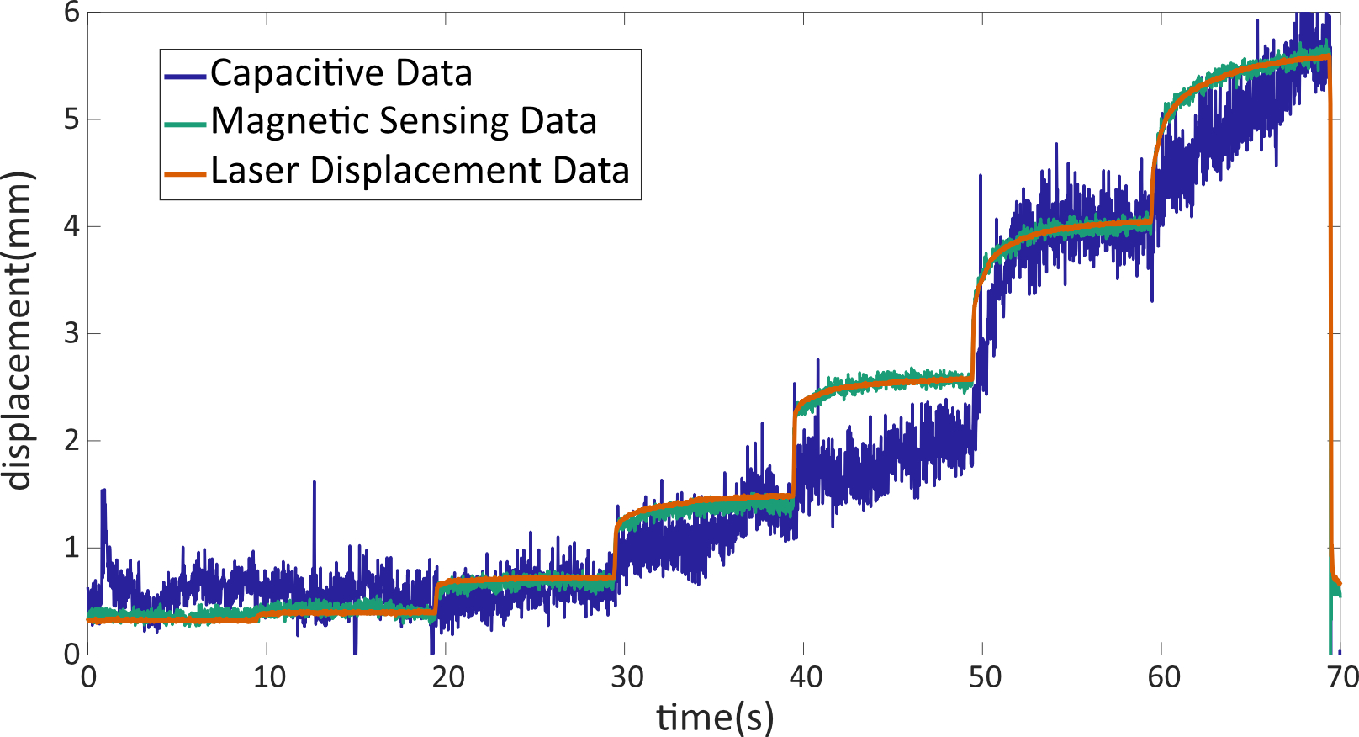
Fitted polynomial relationship between the magnetic sensor output and displacement:
$$z=\left(−3.04×{10}^{−8}\right)B_{z}^{3}+\left(1.60×{10}^{−4}\right)B_{z}^{2}−0.30B_{z}+212.30$$
Laser sensor
Magnetic block
Sensor wrap
Sensor wrap
Magnetic Sensor
Laser Displacement Sensor
Resolution below 0.1 mm
3-axis magnetometer
Dielectric shield
Sampling rate up to 1kHz
Note: only z-axis is used for the fitting
Sundaram, Ly, et. al. (In preparation)
Introduction
Electro-hydraulic Actuator
Research Aim 1
Research Aim 2
Proposed works
References
Slide 5

Slide 6
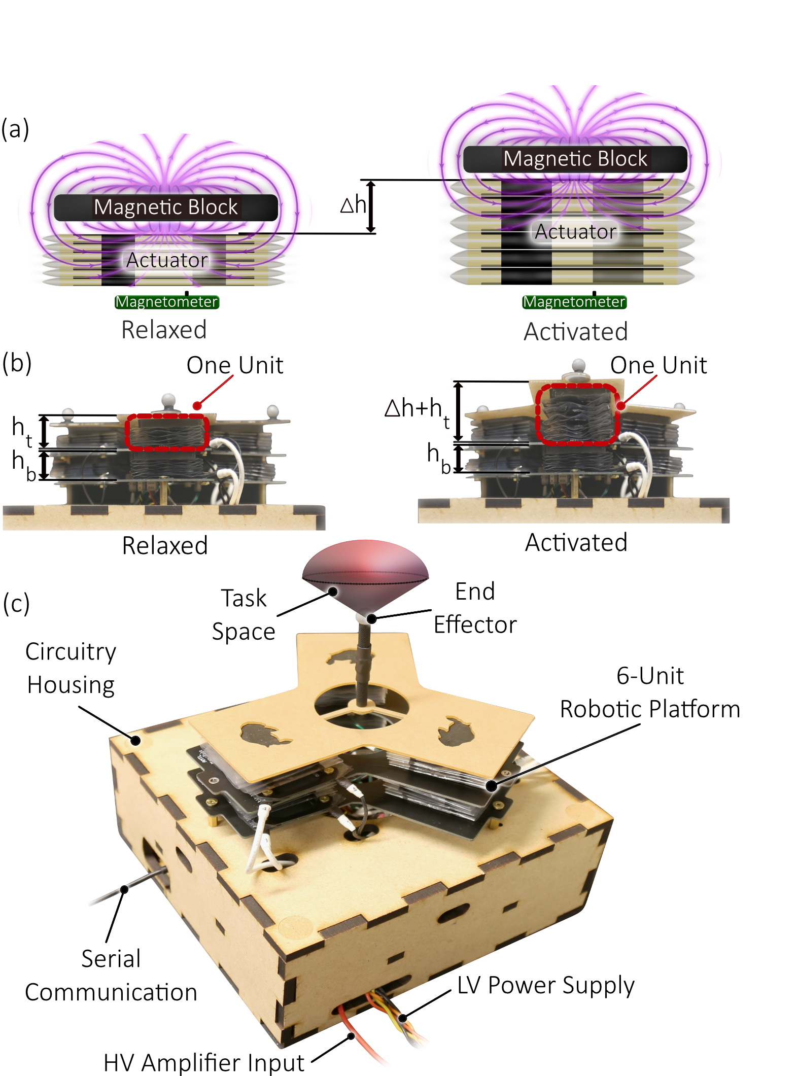
One unit includes the magnetic sensing mechanism (composed of the magnetometer and soft magnetic block) used to measure the change in height, Δh, of a folded HASEL actuator
The front view of the 6-unit deformable robotic platform when relaxed and when one actuator on the top layer is activated. Each layer is comprised of three of the units shown in (a).
An isometric view of the two-segment deformable platform. The task space represents the volume that the deformable platform’s end effector can exist. A high voltage (HV) amplifier provides 8 kV to each of the six actuators, which are individually controlled by a microcontroller unit (MCU). The low voltage (LV) power supply provides 3.3 V to the magnetometers and the low voltage circuit components that control the actuators. The MCU is mounted in the circuitry housing and communicates to a computer via serial communication.
Introduction
Electro-hydraulic Actuator
Research Aim 1
Research Aim 2
Proposed works
References
Slide 6

Slide 7
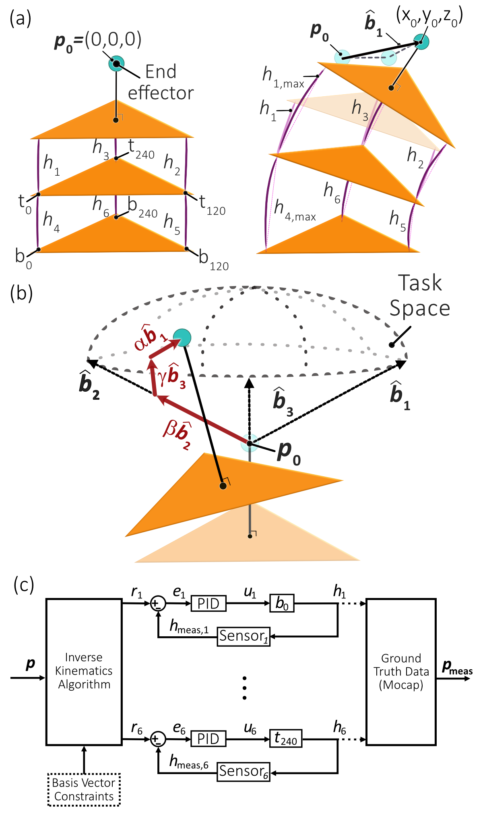
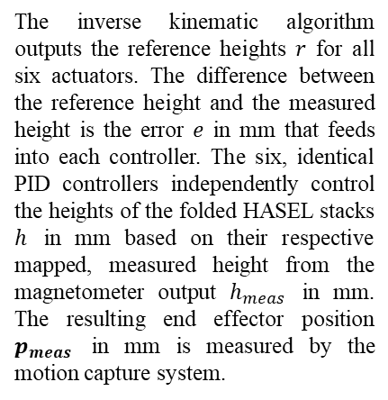
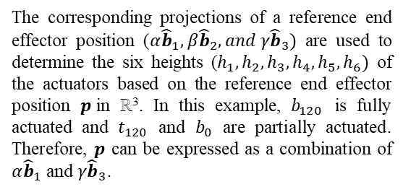
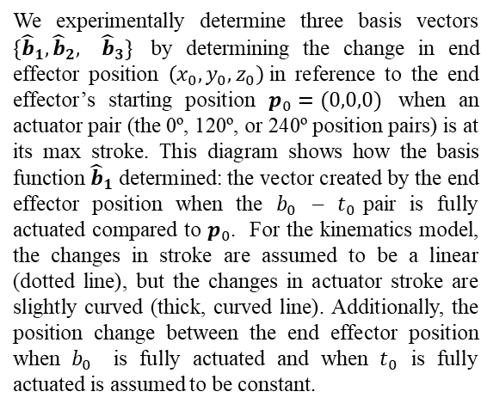
We experimentally determine three basis vectors $\{{\hat{b}}_{1},{\hat{b}}_{2},$ ${\hat{b}}_{3}\}$ by determining the change in end effector position $\left(x_{0}, y_{0}, z_{0}\right)$in reference to the end effector’s starting position $p_{0}=(0,0,0)$ when an actuator pair (the 0º, 120º, or 240º position pairs) is at its max stroke. This diagram shows how the basis function ${\hat{b}}_{1}$ determined: the vector created by the end effector position when the $b_{0}$ – $t_{0}$pair is fully actuated compared to $p_{0}$. For the kinematics model, the changes in stroke are assumed to be a linear (dotted line), but the changes in actuator stroke are slightly curved (thick, curved line). Additionally, the position change between the end effector position when $b_{0}$ is fully actuated and when $t_{0}$ is fully actuated is assumed to be constant.
The corresponding projections of a reference end effector position (${α\hat{b}}_{1}, {β\hat{b}}_{2}, and γ{\hat{b}}_{3})$ are used to determine the six heights ($h_{1}, h_{2},h_{3},h_{4},h_{5},h_{6})$ of the actuators based on the reference end effector position $p$in ℝ³. In this example, $b_{120}$ is fully actuated and $t_{120}$ and $b_{0}$ are partially actuated. Therefore, $p$ can be expressed as a combination of ${α\hat{b}}_{1}$ and $γ{\hat{b}}_{3}$.
The inverse kinematic algorithm outputs the reference heights $r$ for all six actuators. The difference between the reference height and the measured height is the error $e$ in mm that feeds into each controller. The six, identical PID controllers independently control the heights of the folded HASEL stacks $h$ in mm based on their respective mapped, measured height from the magnetometer output $h_{meas}$ in mm. The resulting end effector position $p_{meas}$ in mm is measured by the motion capture system.
Introduction
Electro-hydraulic Actuator
Research Aim 1
Research Aim 2
Proposed works
References
Slide 7

Slide 8
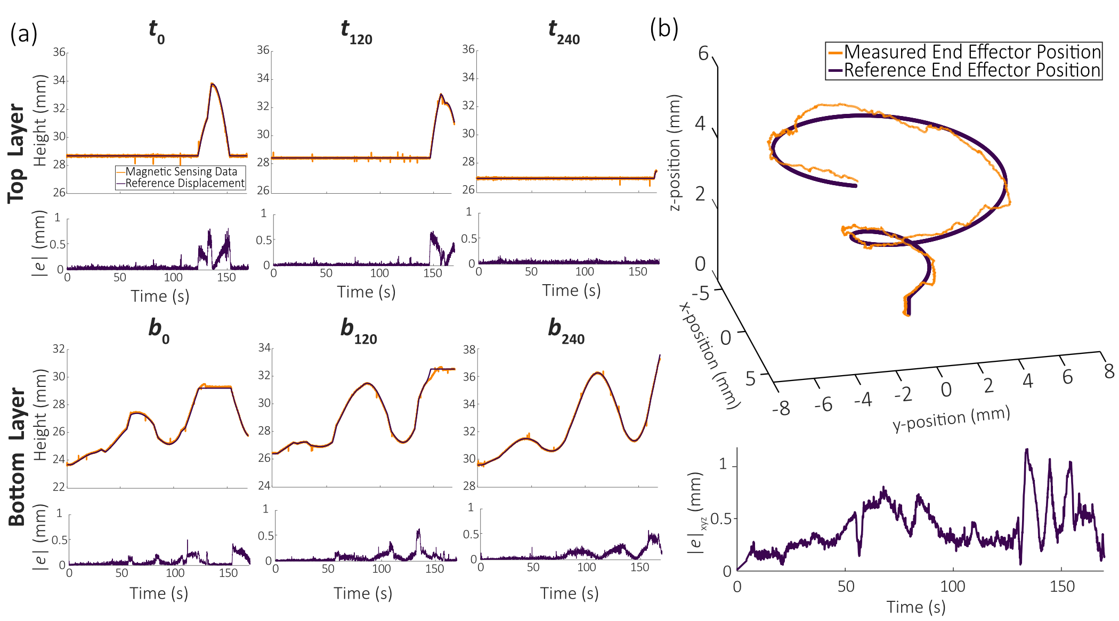
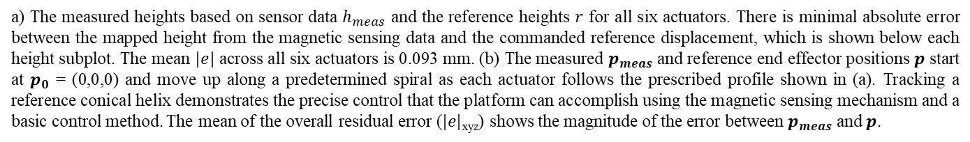
a) The measured heights based on sensor data $h_{meas}$ and the reference heights $r$ for all six actuators. There is minimal absolute error between the mapped height from the magnetic sensing data and the commanded reference displacement, which is shown below each height subplot. The mean $|e|$ across all six actuators is 0.093 mm. (b) The measured $p_{meas}$ and reference end effector positions $p$ start at $p_{0}$ = (0,0,0) and move up along a predetermined spiral as each actuator follows the prescribed profile shown in (a). Tracking a reference conical helix demonstrates the precise control that the platform can accomplish using the magnetic sensing mechanism and a basic control method. The mean of the overall residual error ($|e|$_{xyz}) shows the magnitude of the error between $p_{meas}$ and $p$.
Introduction
Electro-hydraulic Actuator
Research Aim 1
Research Aim 2
Proposed works
References
Slide 8

